Slide 1

SW 중심대학의 SW 실무교육
2019. 06. 24
발표자: 이 영 학

Slide 2
Adaboost based Two-wheeler Detection System using DoG Operator and NCC Calculation
Yeunghak Lee*, Taesun Kim*, Jaechang Shim**
* Dept. of Avionics Electronic Eng., Univ. of Kyungwoon, Korea
** Dept. of Computer Sci., National Andong Univ., Korea
July 4, 2016

Slide 3
Sequence
Introduction
Feature extraction
  Histogram of Oriented Gradients
  Normalized Correlation Coefficient
  Difference of Gaussian
Classification
Experimental Results
Conclusion

Slide 4
Introduction
Intelligent Vehicle System
  Lane detection.
  Lane departure Warning.
  Vehicle detection.
  Pedestrian detection.
  Blind spot detection.
  Drowsy driver monitoring.
  etc.

Slide 5
Introduction
Object detection feature extraction
  Haar-like feature.
  Histogram of Oriented Gradients.
  Principle Component Analysis.
  Local Binary Pattern.
Classification
  Boosting.
  Adaboost.
  Support Vector Machine.

Slide 6
Introduction
Previous Work for Intelligent Vehicle
  Detection vehicles and pedestrian.
  Improve Algorithm and Electronic Device.
Proposed Work
  Detection Vulnerable Road Users.
    Bicycle, Motorbike, Small bike, etc.
  Normalized Correlation Coefficient.
  Adaboost.

Slide 7
Feature Extraction
Histogram of Oriented Gradients
Haar-like
Local Binary Pattern
Wavelet
PCA
Projection Vectors
Variants of HOG and LBP
etc.

Slide 8
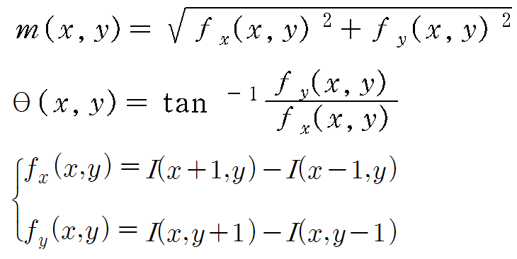
HOG Feature
Histogram of Oriented Gradients

Slide 9

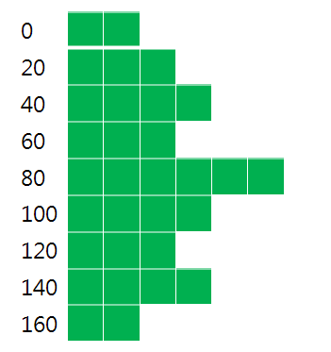



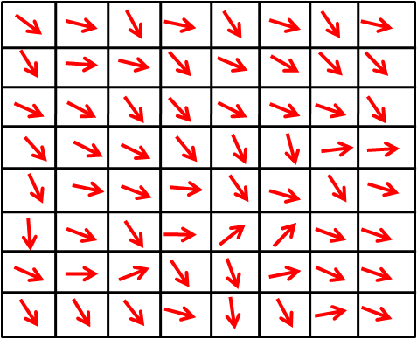
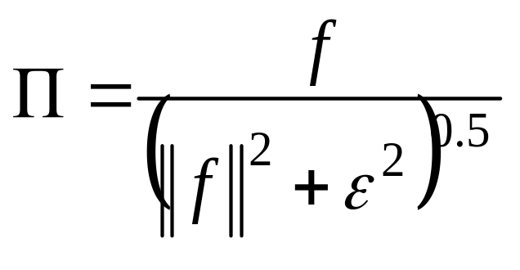
HOG Feature
Cell Histogram
Block Normalization

Slide 10
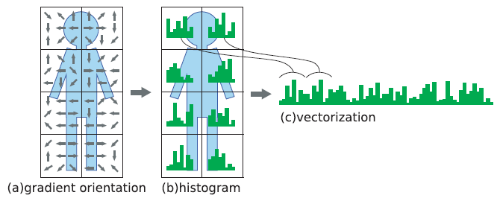
Feature Vectorization
General Method -Concatenation

Slide 11
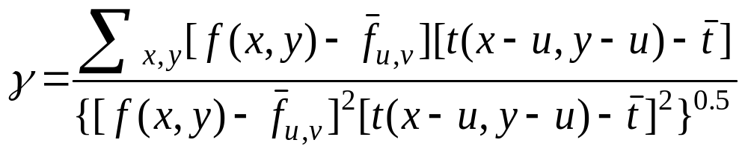
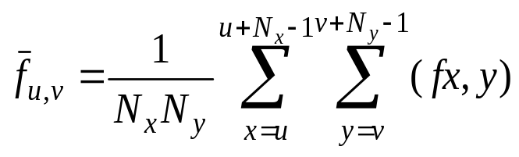
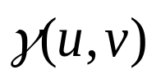
NCC(Normalized Correlation Coefficient)
Overcome disadvantage for the cross correlation
Used to decide the similarity between two images.
- independent to change in brightness or contrast of the image

Slide 12
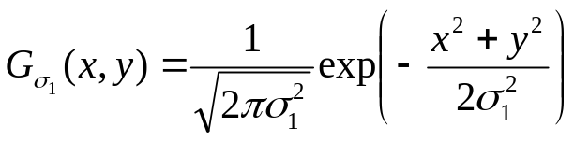
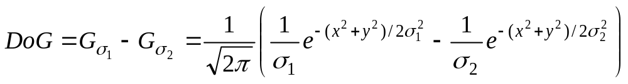
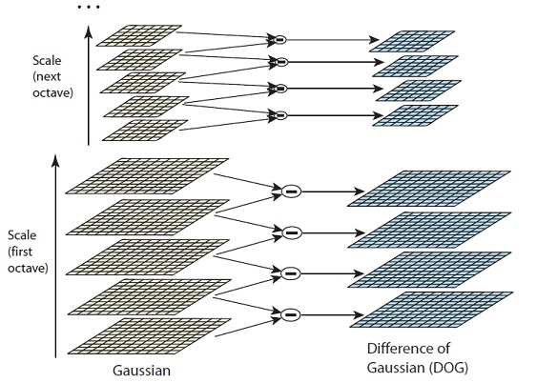
Difference of Gaussian
Two stage edge detection process
Performing two different Gaussian blurs on the image.
Gaussian kernel
DoG kernel

Slide 13
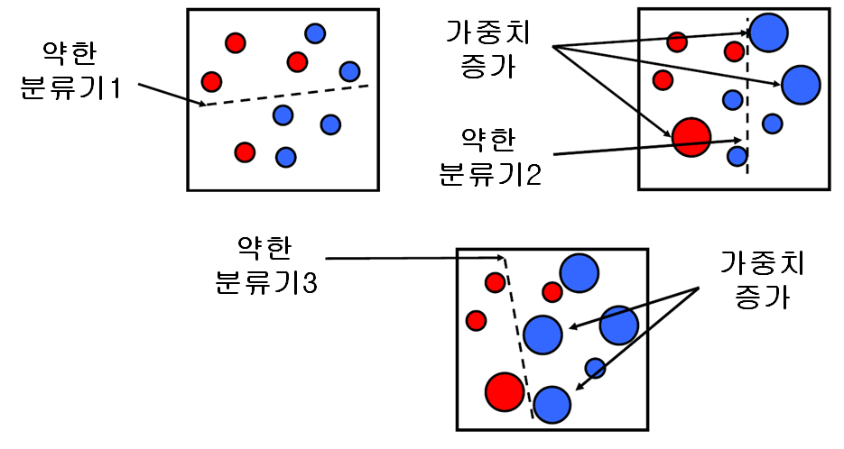
Classification-Adaboost
Weak Classifiers and Strong Classifier
Update
Weights
Weak
Classifier1
Weak
Classifier2
Weak
Classifier3
Update
Weights

Slide 14
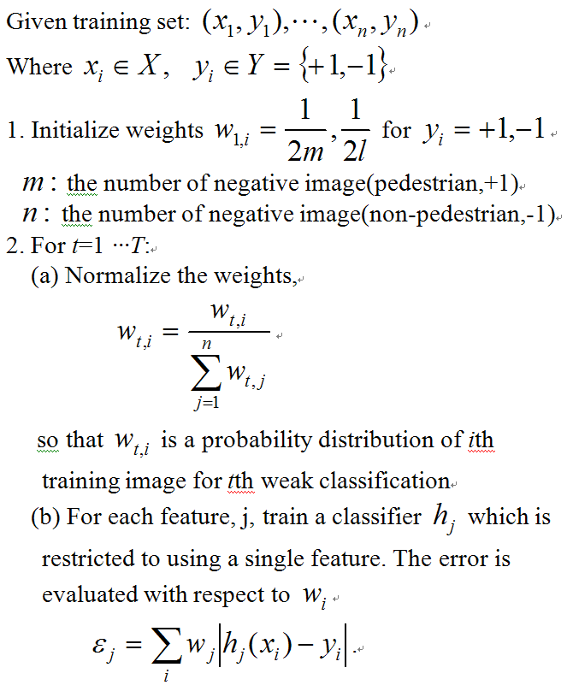
Classification-Adaboost

Slide 15
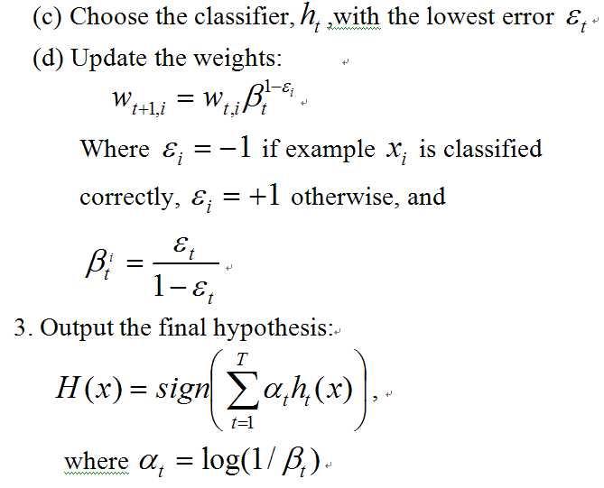
Classification-Adaboost(cont.)

Slide 16
Experiment Results
Image Size : 128x64
Training image (Positive: Negative -> 1:1)
Test image (Positive) – Negative : 3000
Angle Type | 60 | 90 | 60+90
Bike | 340 | 845 | 1,185
Moto | 96 | 234 | 330
Bike+Moto | 436 | 1,079 | 1,515
Angle Type | 60 | 90 | 60+90
Bike | 305 | 863 | 1,168
Moto | 80 | 219 | 299
Bike+Moto | 385 | 1,082 | 1,467

Slide 17
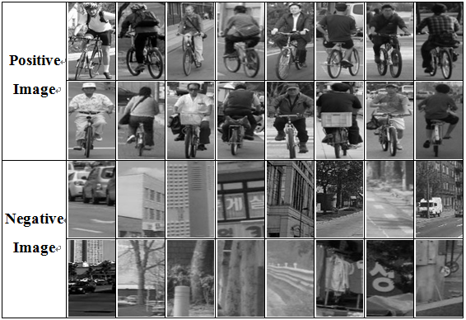
Experiment Results
Image Size : 128x64
Training image (Positive: Negative -> 1:1)
Test image (Positive) – Negative : 3000
Angle Type | 60 | 90 | 60+90
Bike | 340 | 845 | 1,185
Moto | 96 | 234 | 330
Bike+Moto | 436 | 1,079 | 1,515
Angle Type | 60 | 90 | 60+90
Bike | 305 | 863 | 1,168
Moto | 80 | 219 | 299
Bike+Moto | 385 | 1,082 | 1,467

Slide 18
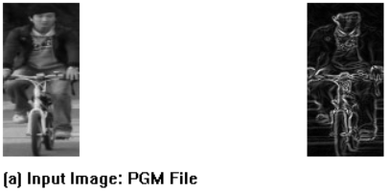
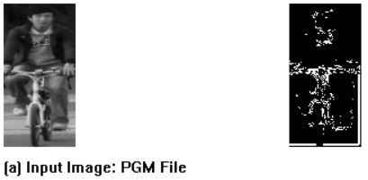
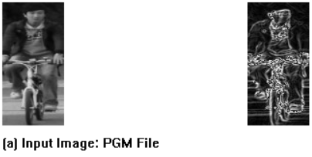

Experiment Results(cont.)
Proposed Algorithm(HOG and DoG)
  The result of HOG and Dog.
  (a) HOG (b) DoG
  Using HOG + DoG value
H(x,y) : magnitude of HOG
D(x,y) : The result of Gaussian Kernel

Slide 19
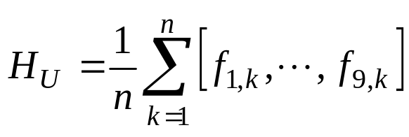
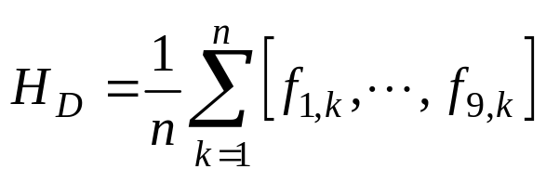
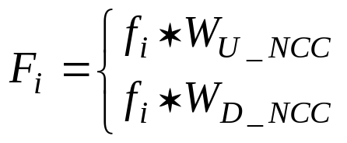






Experiment Results(cont.)
Proposed Algorithm(NCC to Cell)
  Two wheelers consist of human and bike.

Slide 20
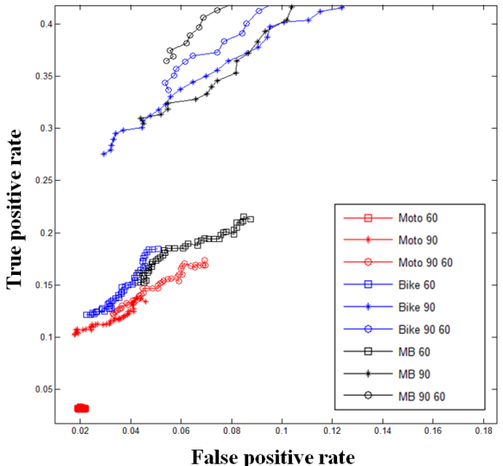
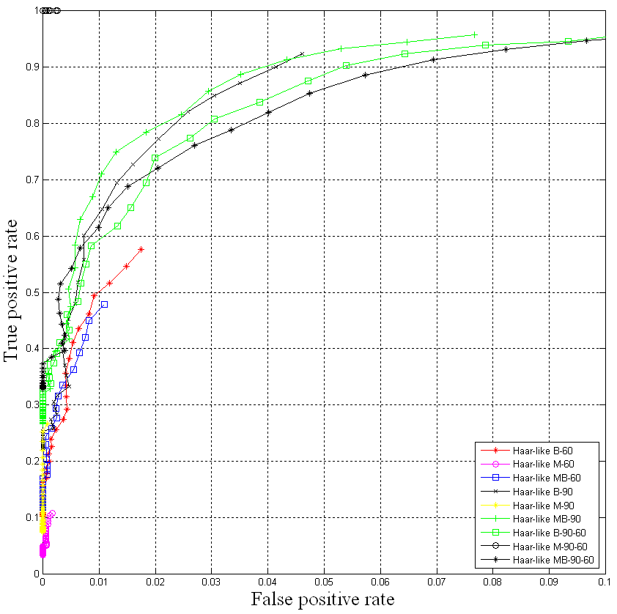
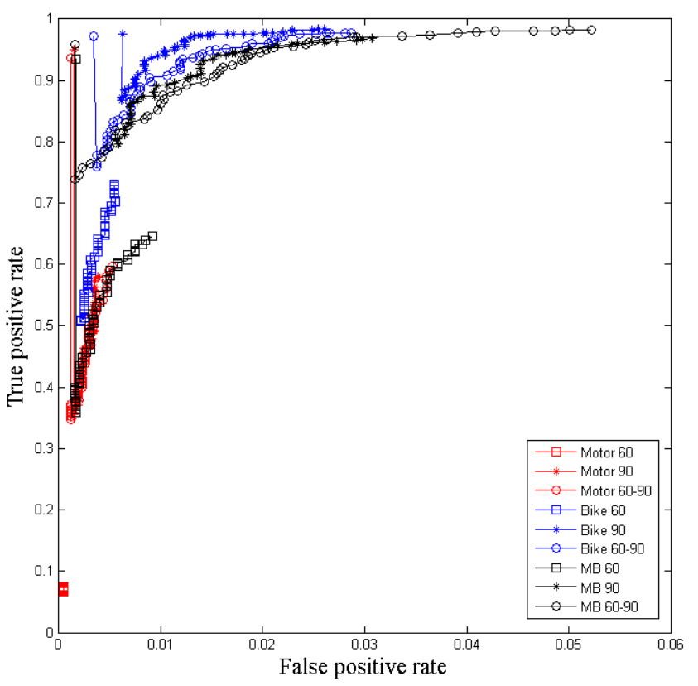
Experiment Results(cont.)
(a)
(b)
(c)
Fig.1. Experiment Results : (a) Results of an ordinary HOG Method, (b) Results of the Haar-like experiment, (c) Results of the NCC weighted experiment by applying the suggested algorithm.

Slide 21
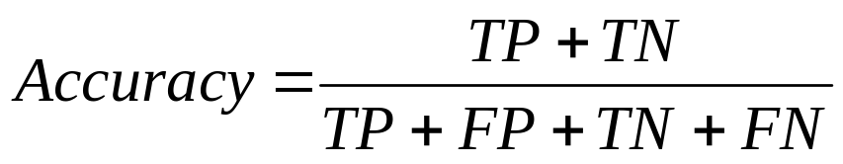
Experiment Results(cont.)
Method Angle |  | HOG | Haar-like | G_HOG
60 | M | 61.1 | 79.3 | 68.7
 | B | 71.2 | 92.8 | 96.3
 | MB | 76.7 | 87.7 | 94.4
90 | M | 74.9 | 81.3 | 95.0
 | B | 78.3 | 94.8 | 98.4
 | MB | 76.1 | 94.6 | 97.4
90-60 | M | 77.8 | 98.0 | 93.7
 | B | 75.5 | 93.5 | 97.6
 | MB | 73.1 | 92.5 | 97.2
Experiment Results (Accuracy).

Slide 22
Conclusion
Motivation
  Compare cell information.
  Edge information
Proposed Features
  Calculated HOG and DoG
  NCC weighting value.
Future works
  Several view angle and try to other VRU.
  Improve Recognition Rate and Reduce feature numbers.

Slide 23
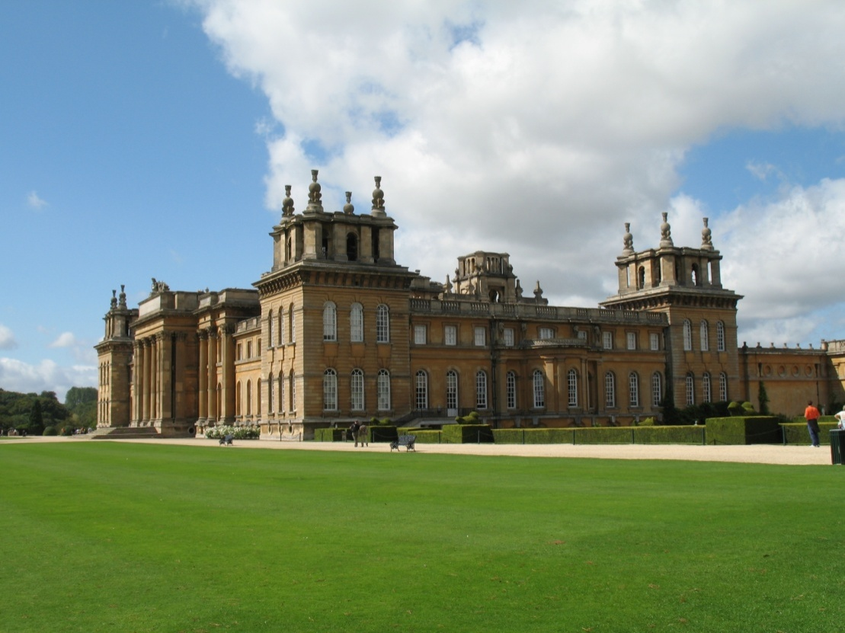
Thanks for your attention!

